Slide 1
BRITISH AIRWAYS TASK 1

Slide 2
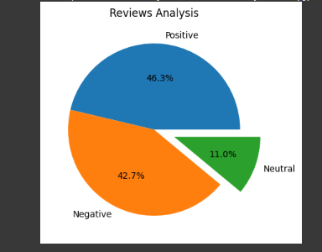
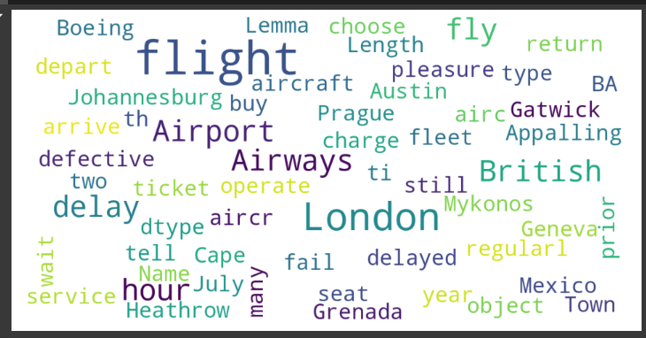
EDA Summary
From cleaning 1000 reviews given by the customers, we obtained
Positive Reviews - 463
Negative Reviews - 427
Neutral Reviews – 110

